Slide 1
Plane trusses
1. Analysis of truss is the process of finding the forces in the member of a truss.
2. A framed structure is an assemblage of a no. of bars or rods (straight) joined together in such a way to form a rigid framework.
3. This structure is designed to resist geometrical distrotion under any applied loading. The ends are joined by riveting, welding or by nuts and bolts.
4. The bars are called two – force members because they are either in tension or compression.

Slide 2
Assumptions
Truss members are connected only at their ends.
Truss members are connected by frictionless pins
Trusses are loaded only at the joints
The weight of the members may be neglected.

Slide 3
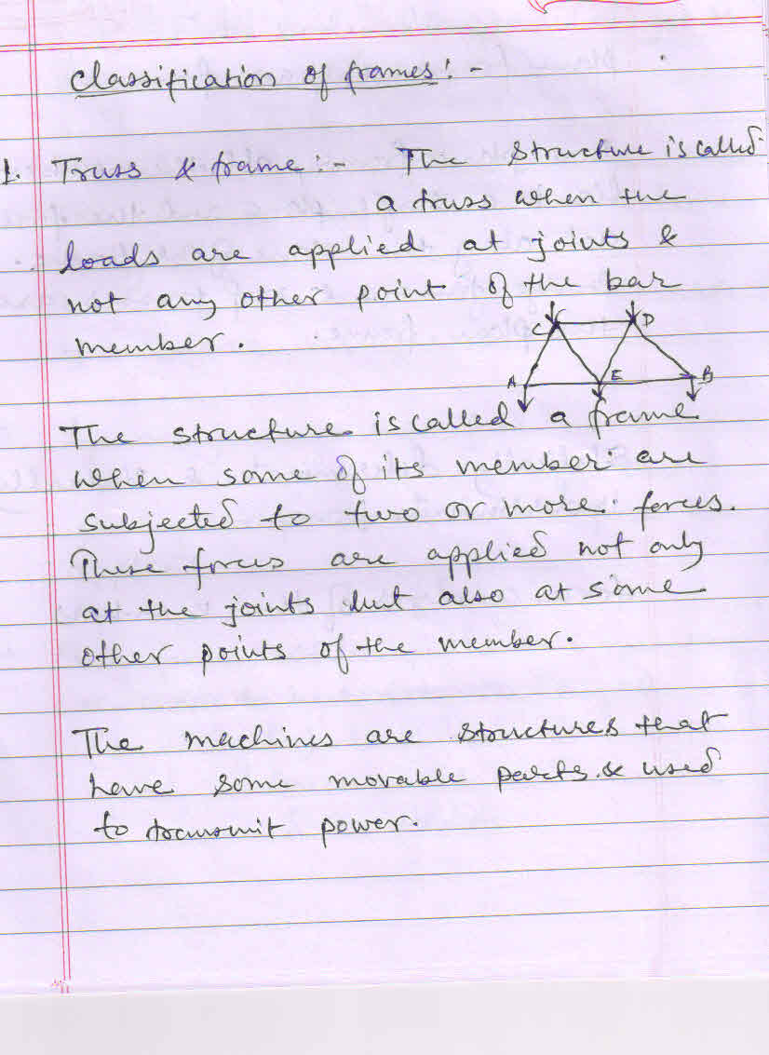

Slide 4
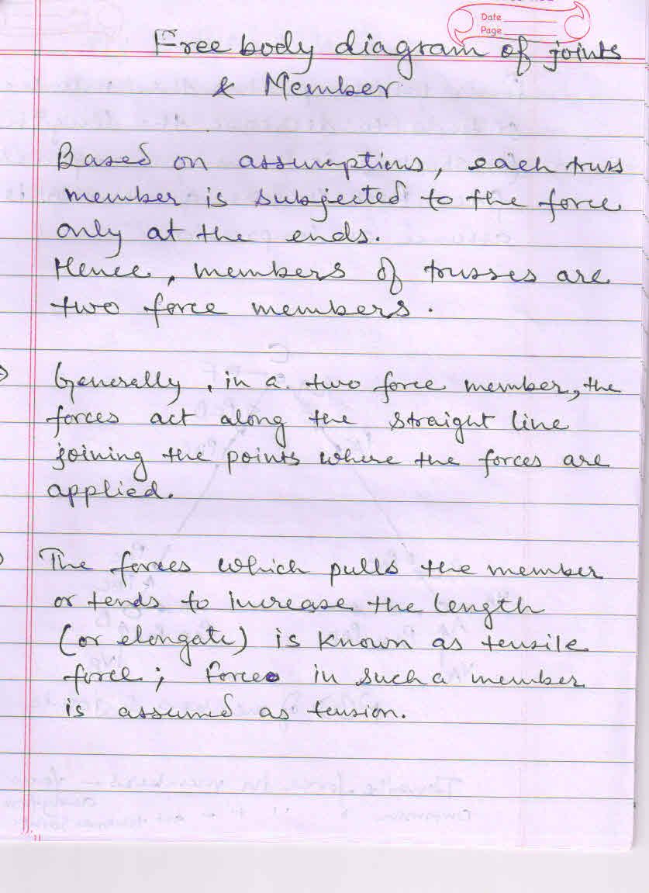

Slide 5
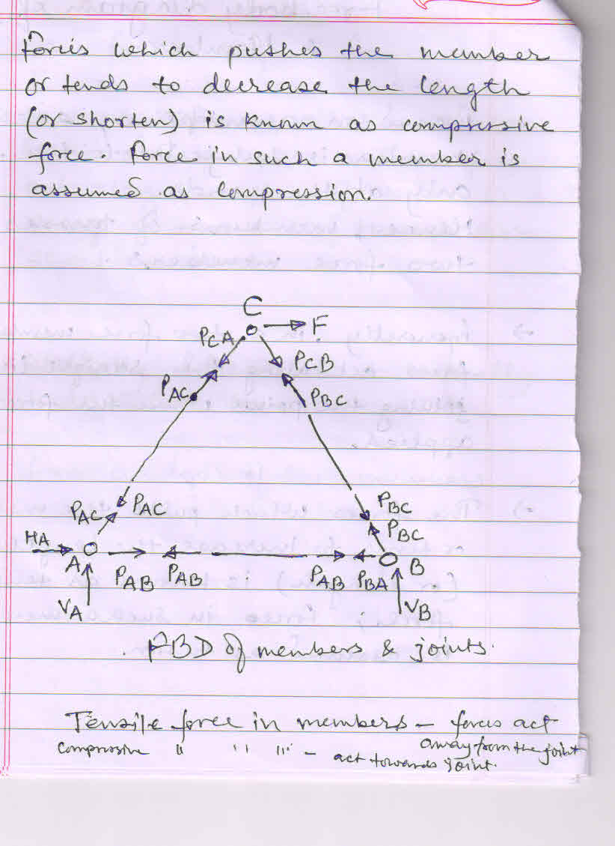

Slide 6
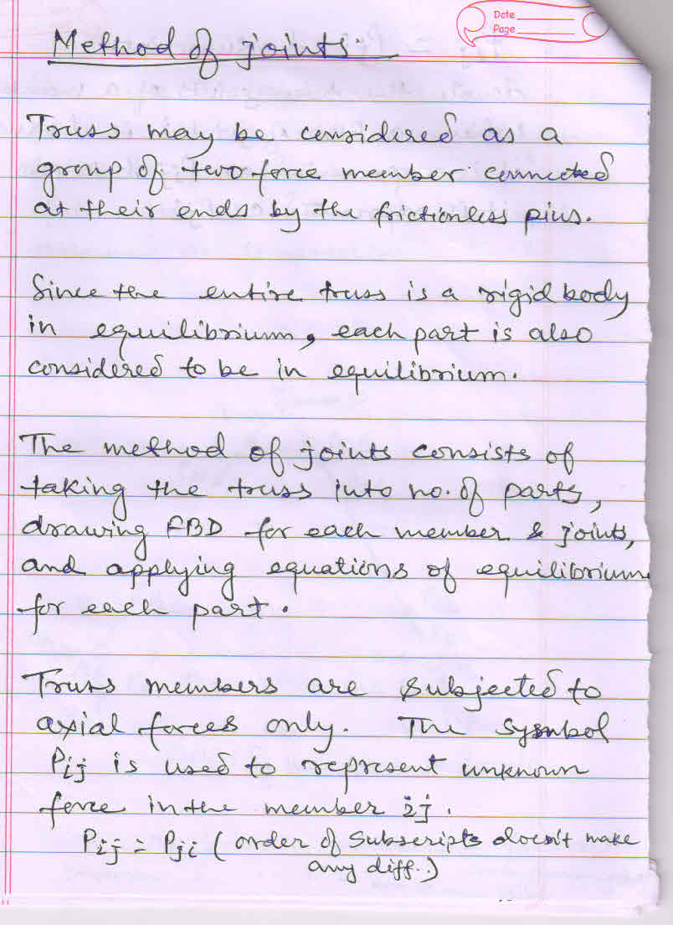

Slide 7
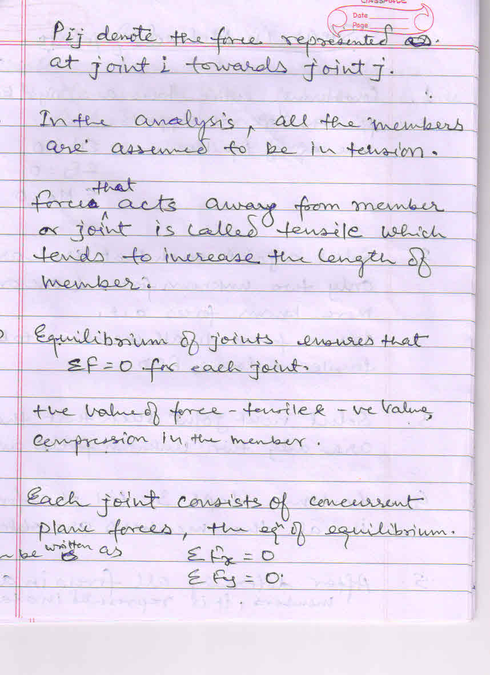

Slide 8
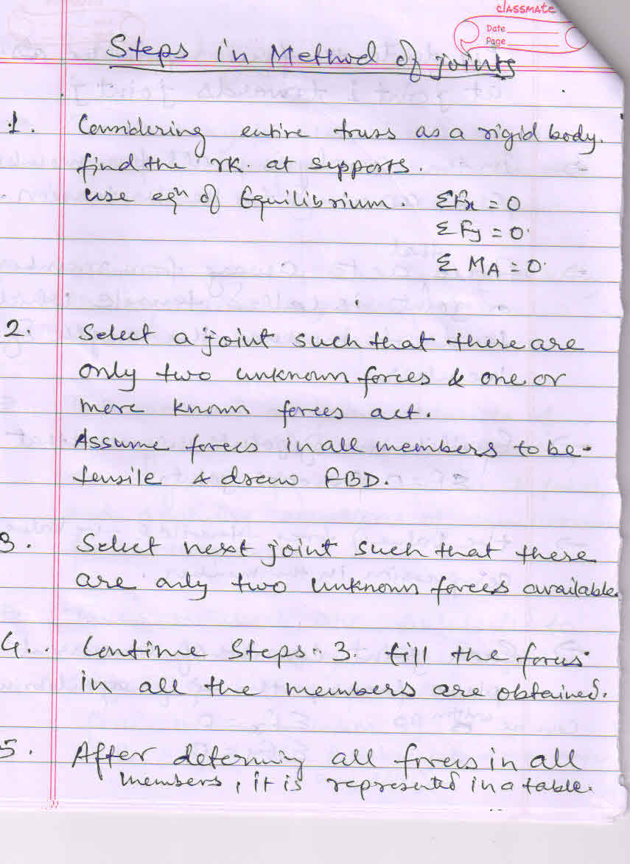

Slide 9
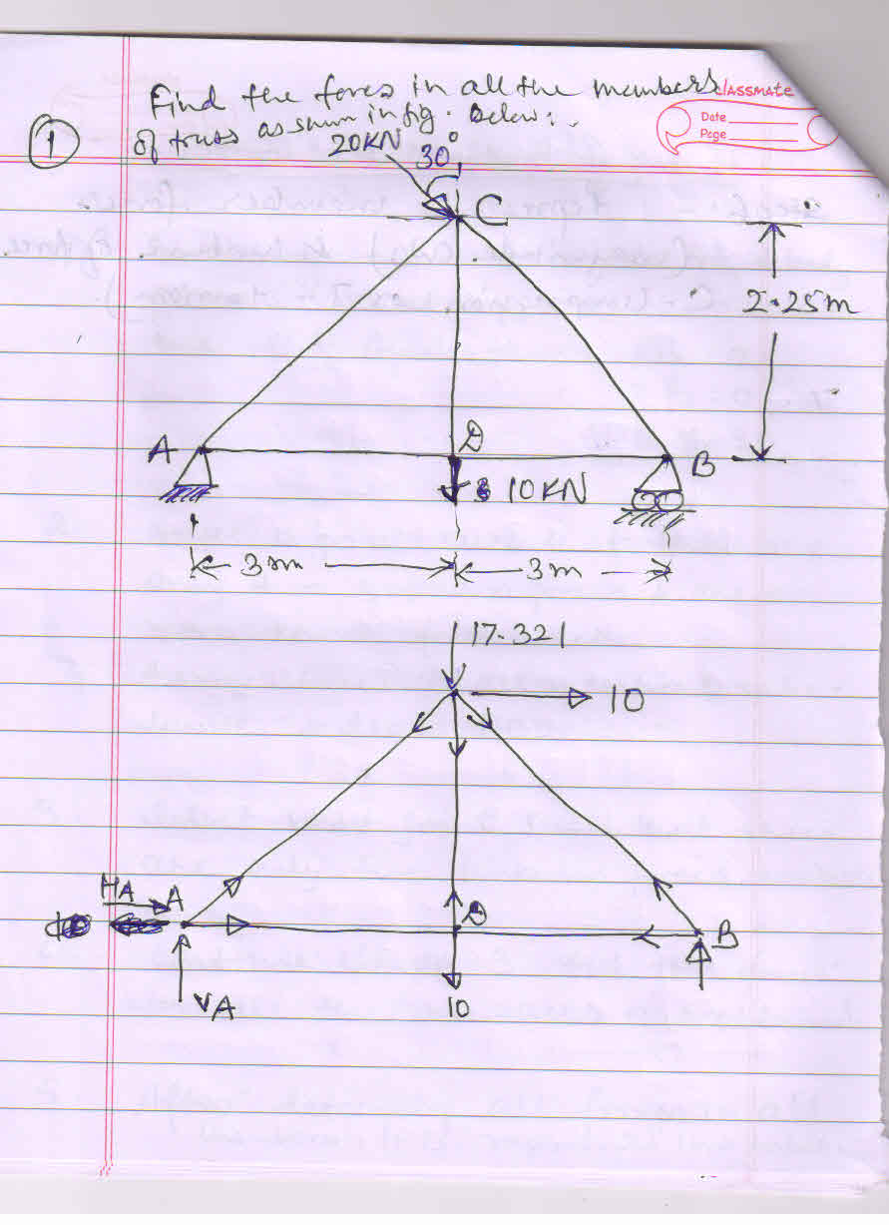

Slide 10
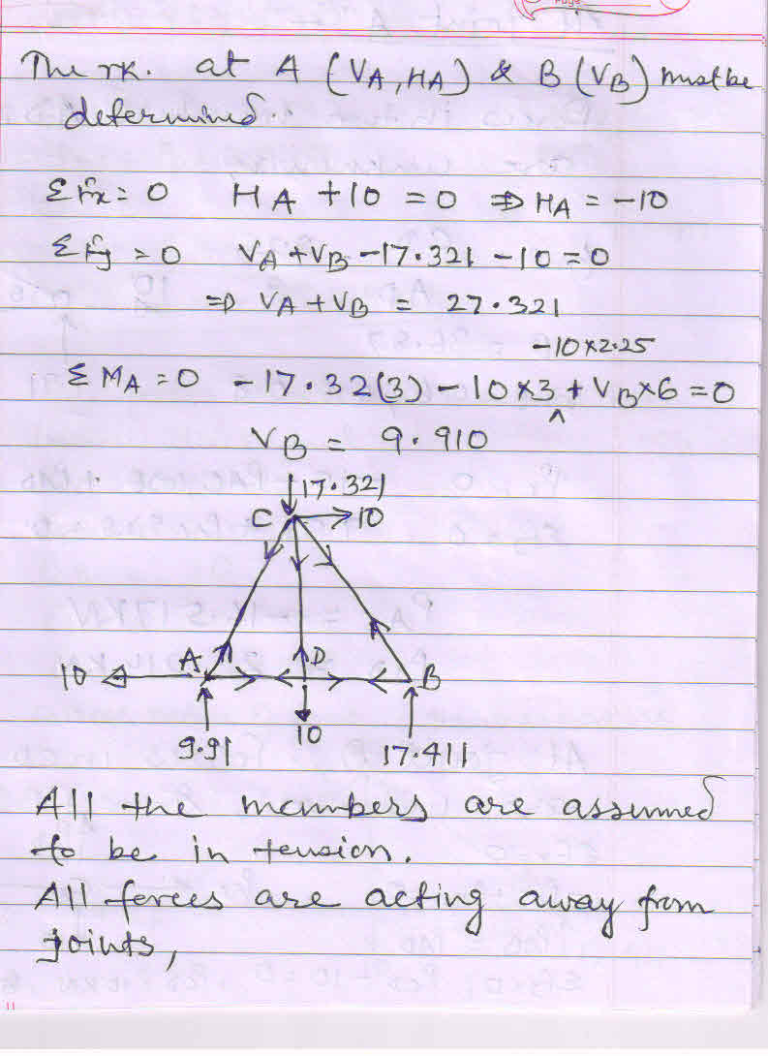

Slide 11
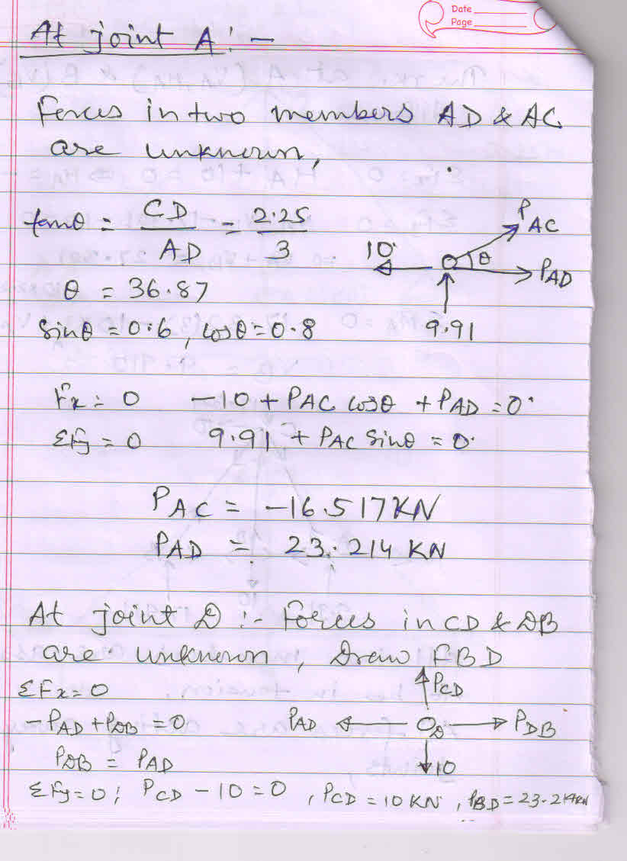

Slide 12
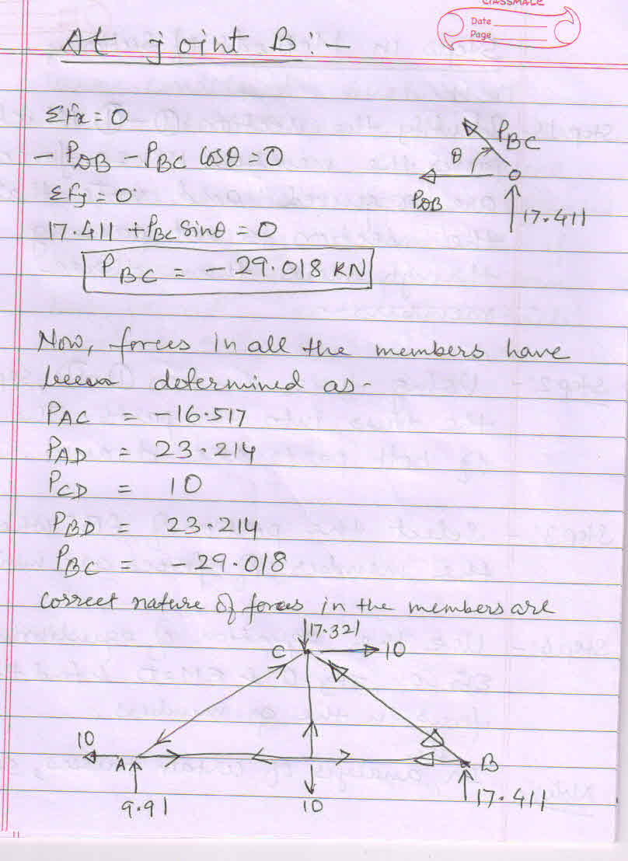

Slide 13
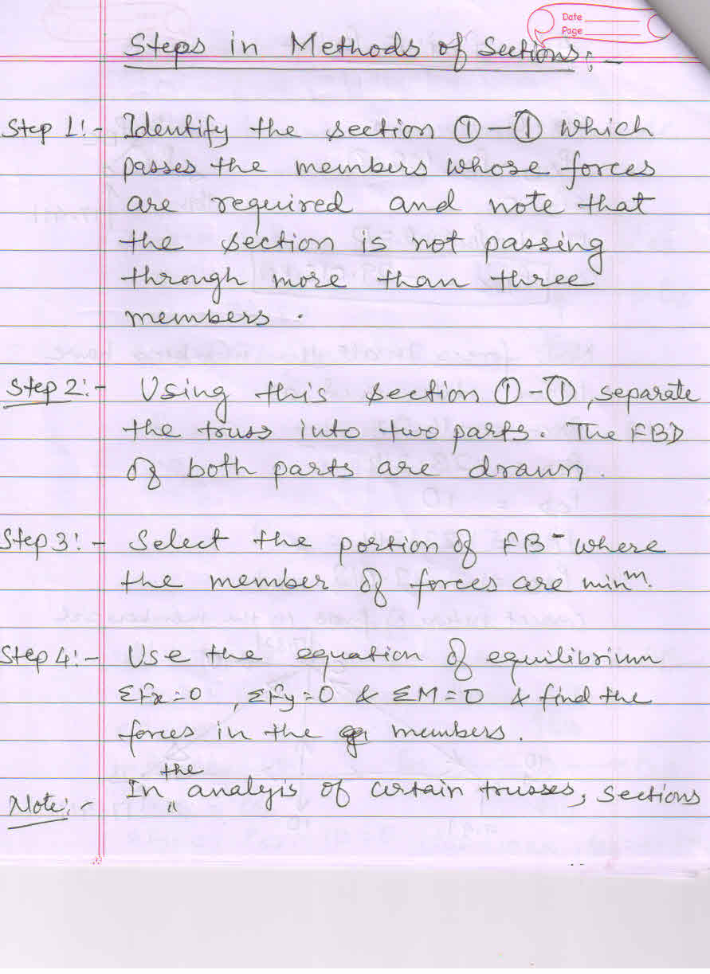

Slide 14
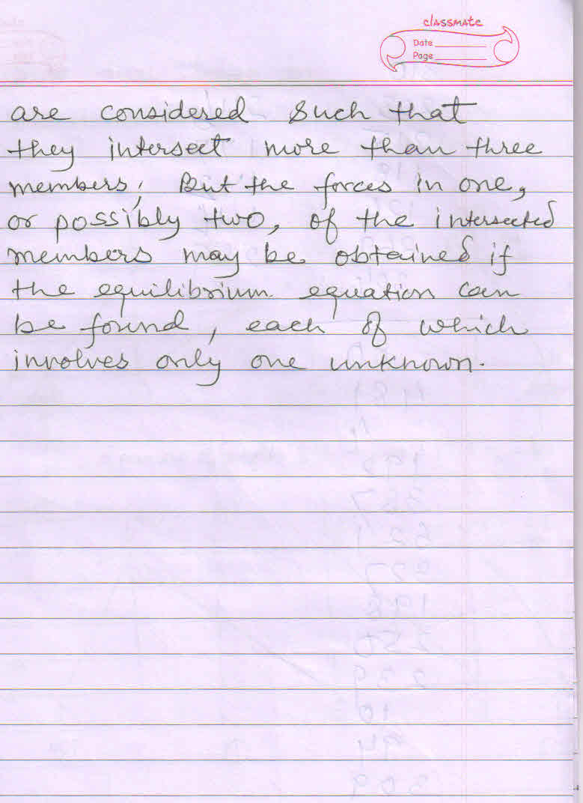

Slide 15
